Slide 1
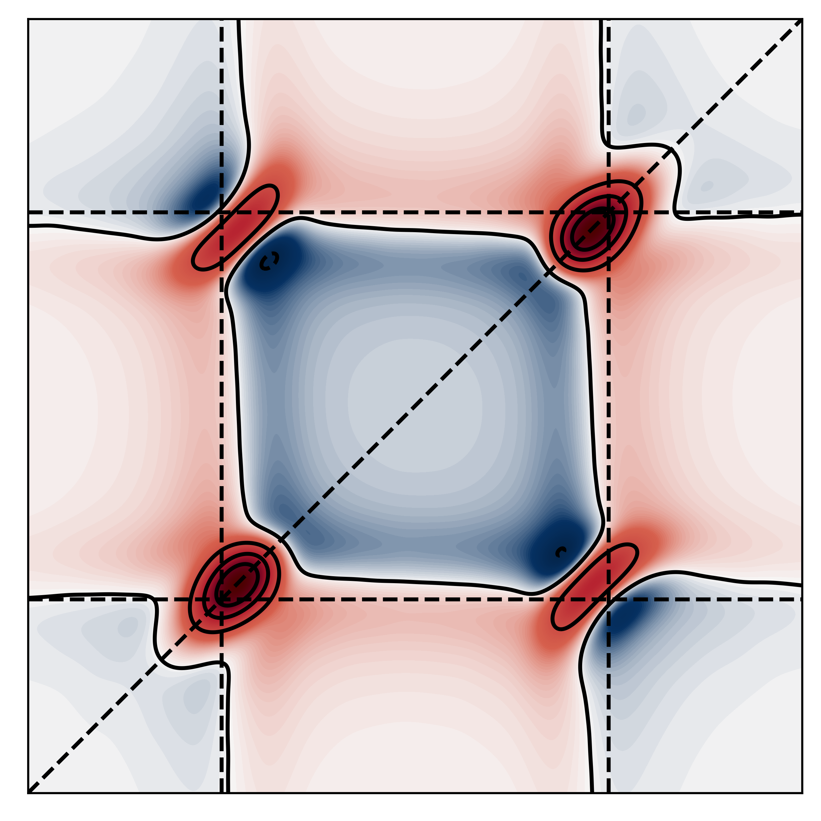
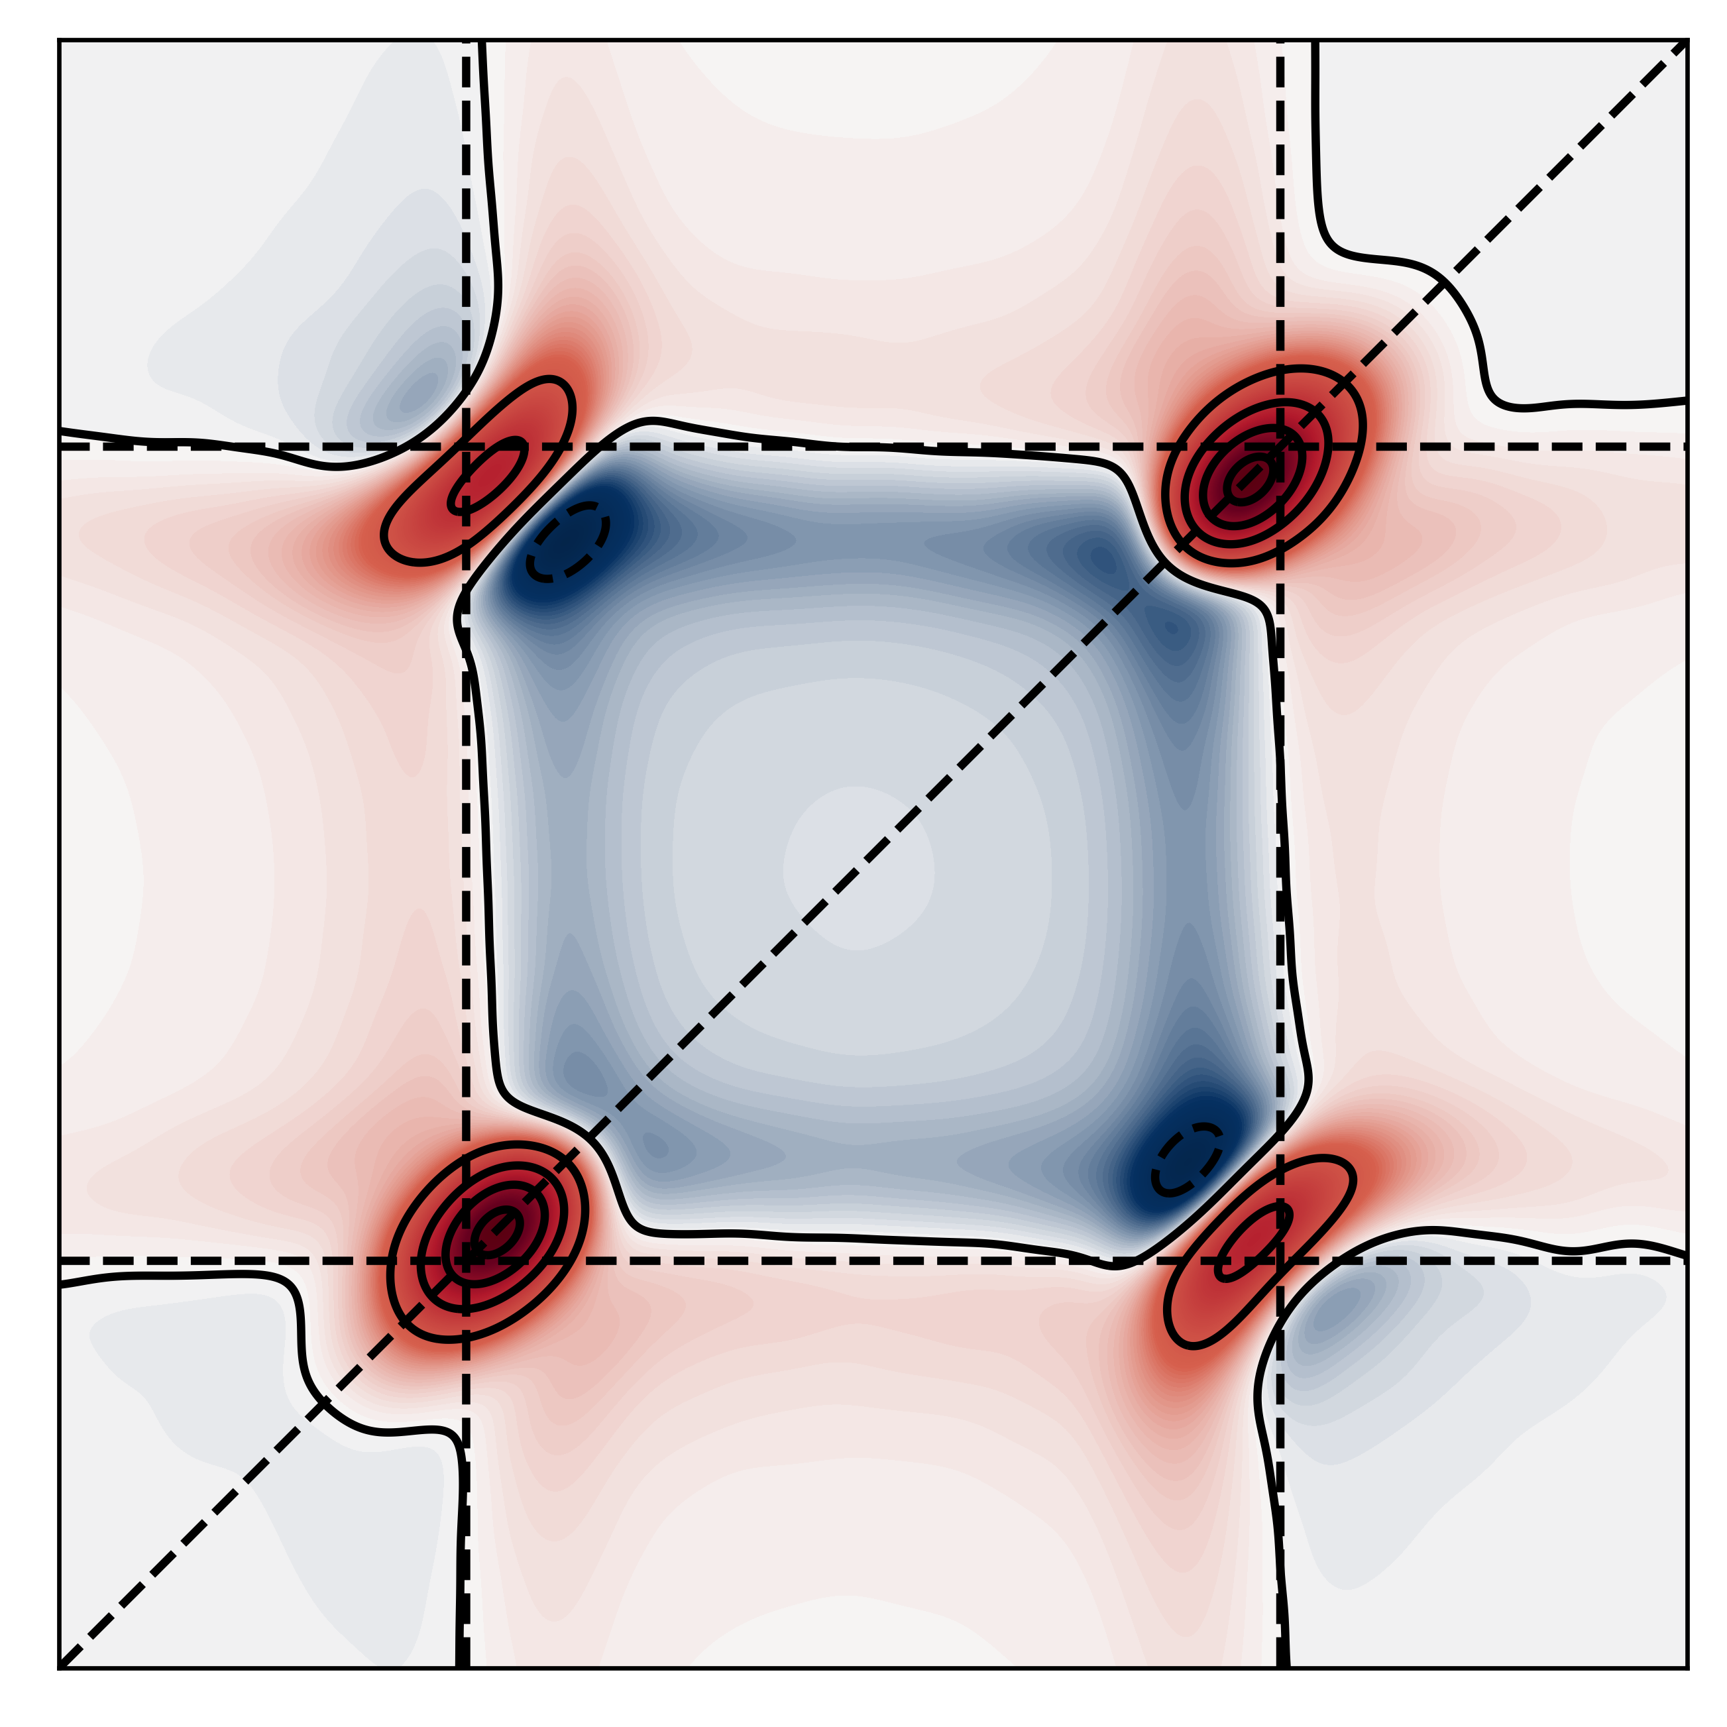
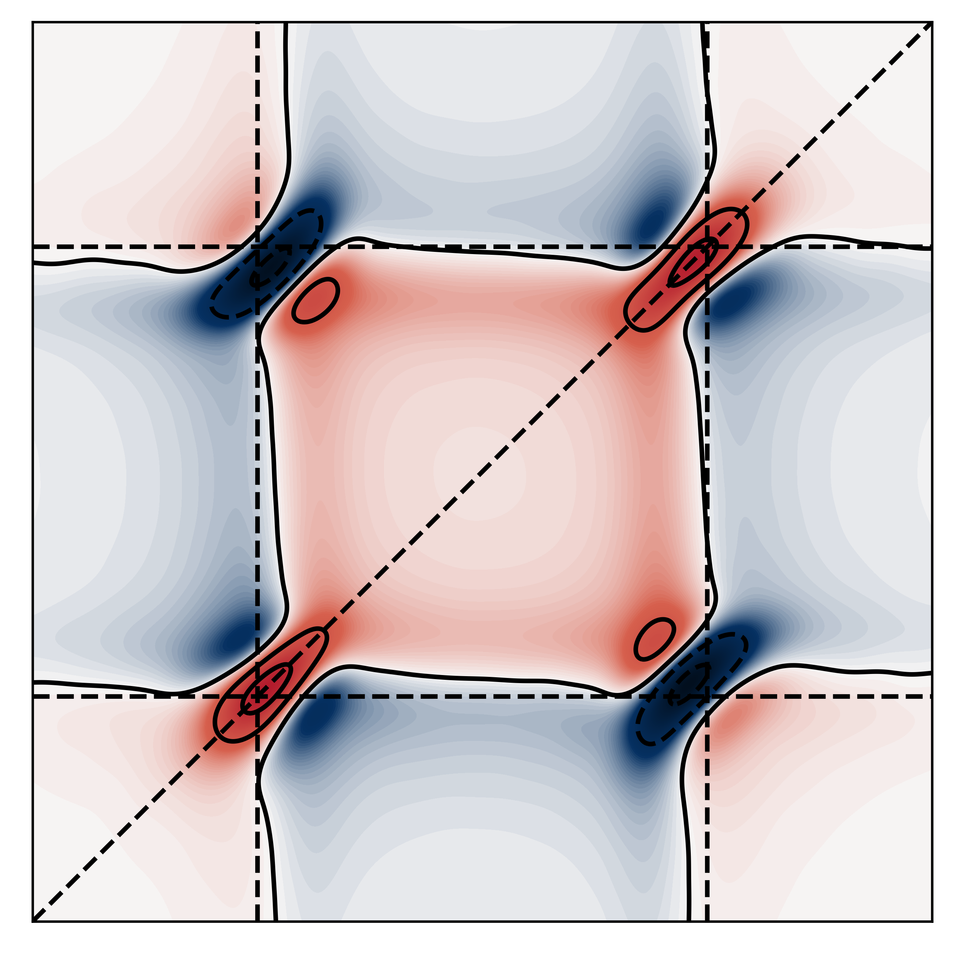

Quantum Dynamics Simulations of Polariton Spectroscopy
Elious Mondal

Slide 2
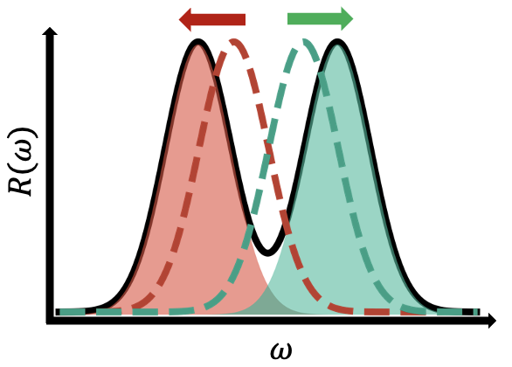
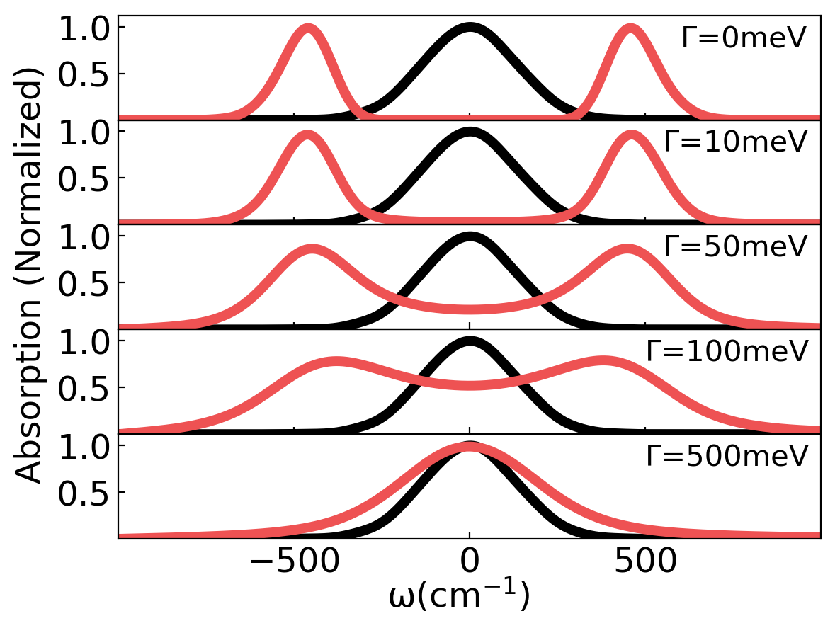
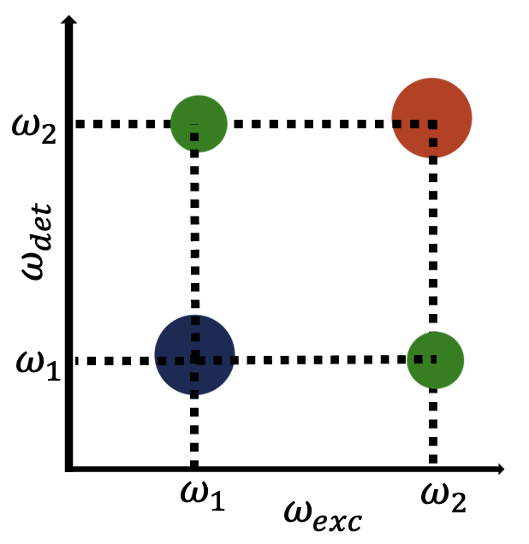
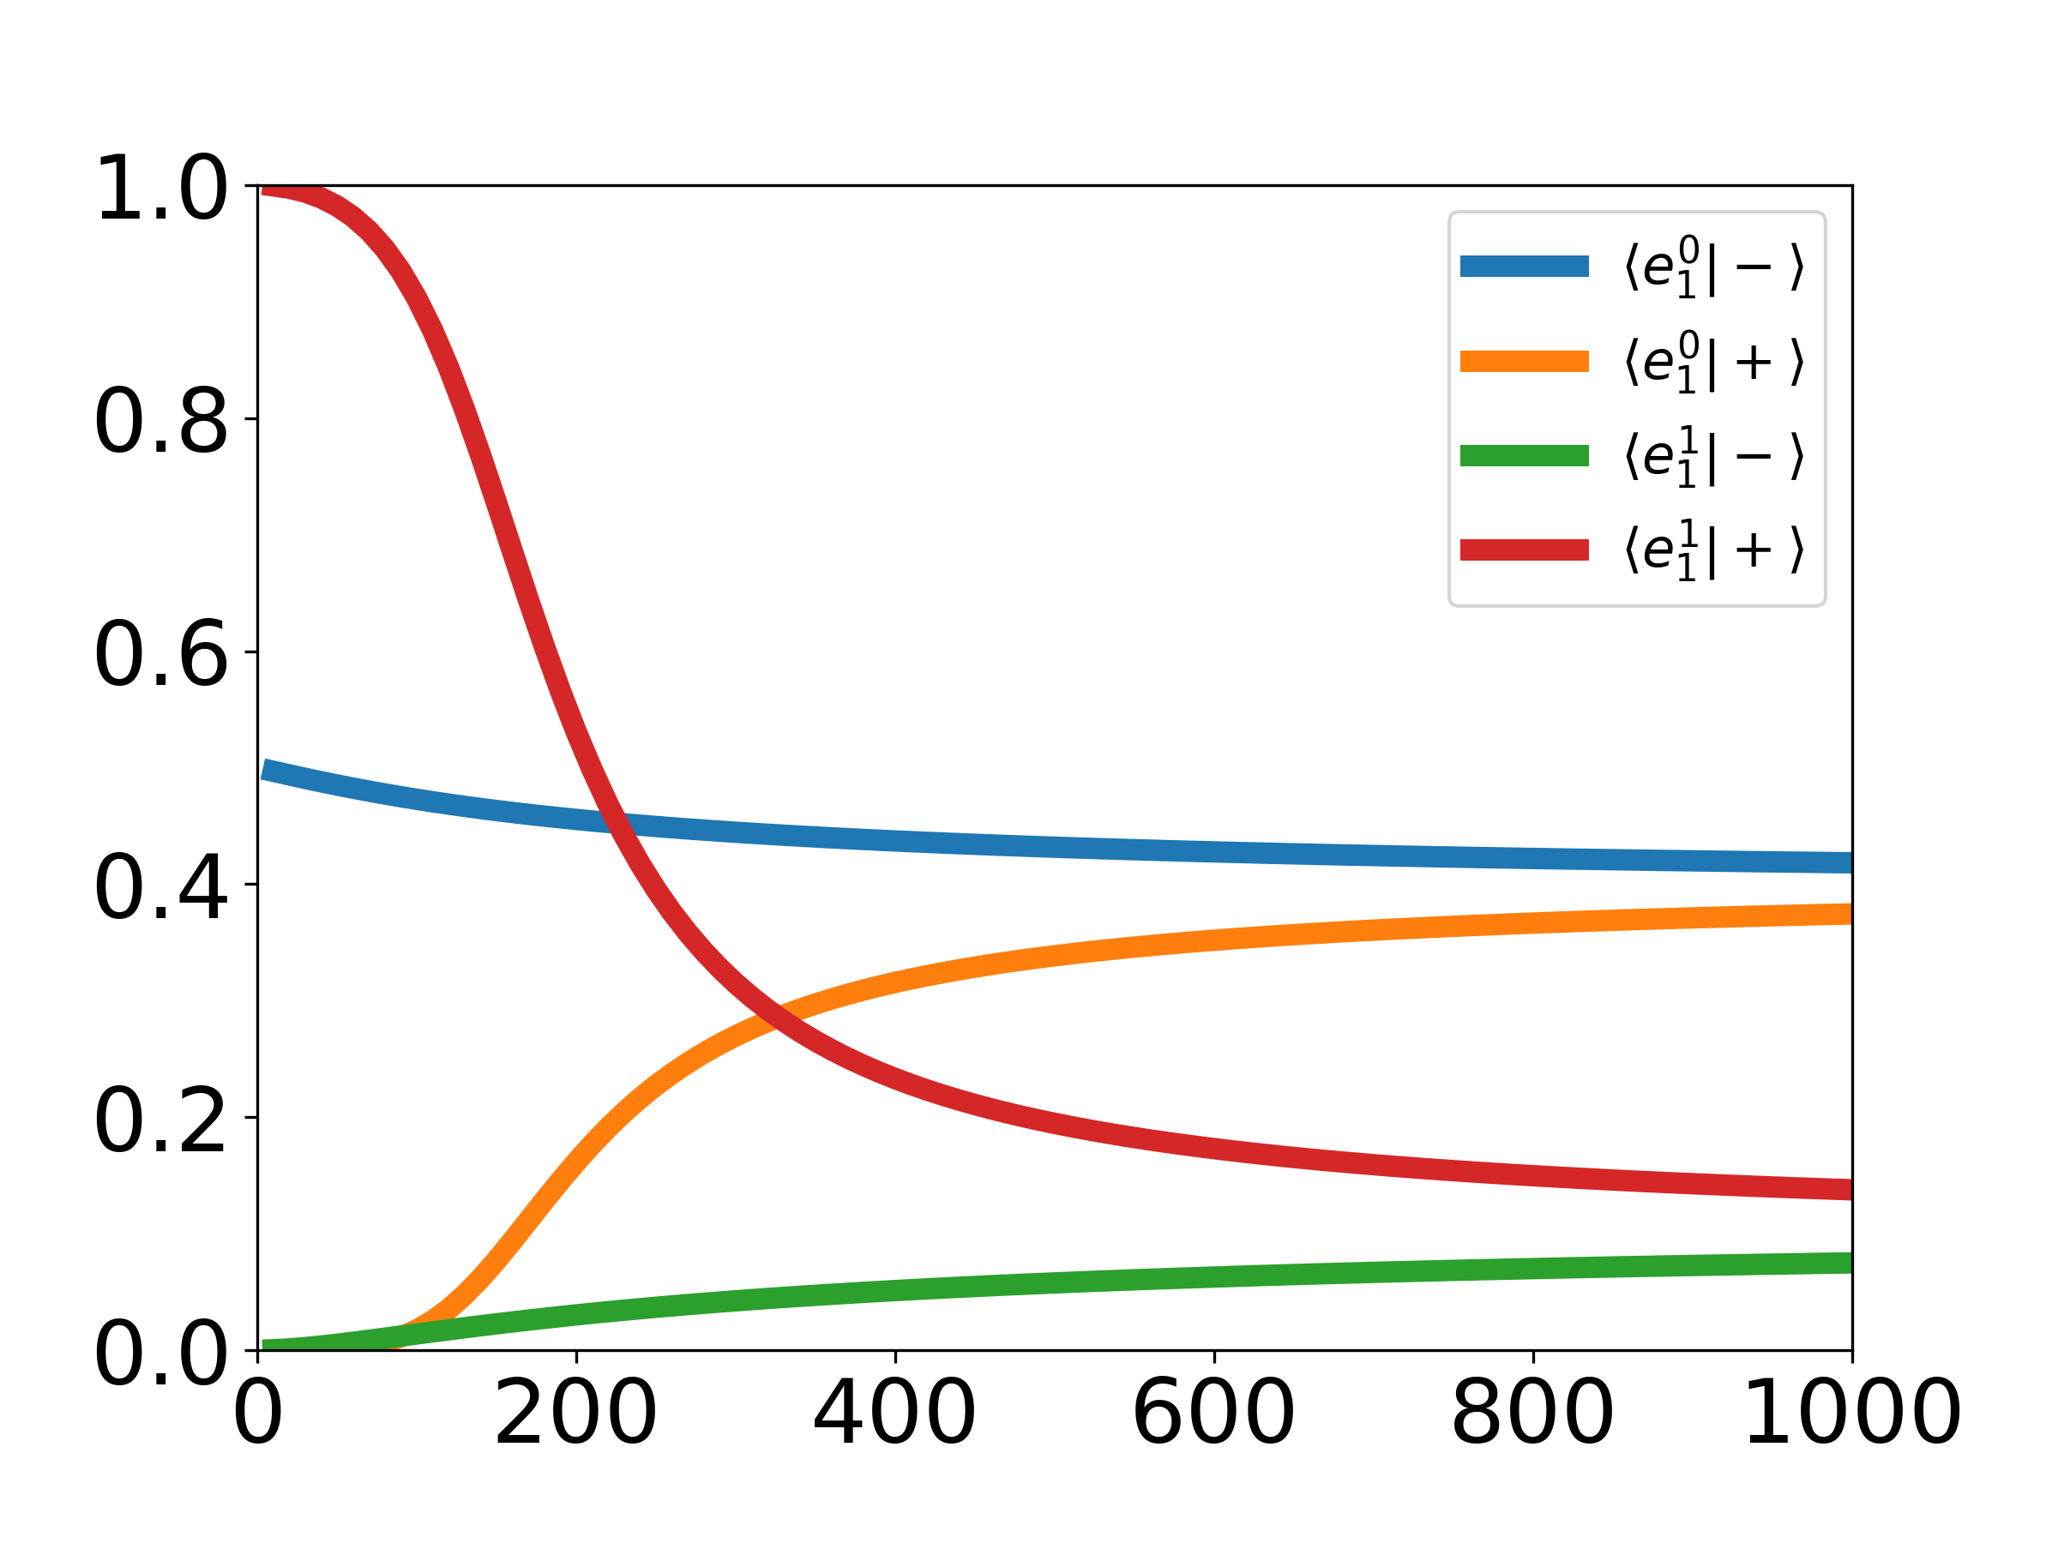
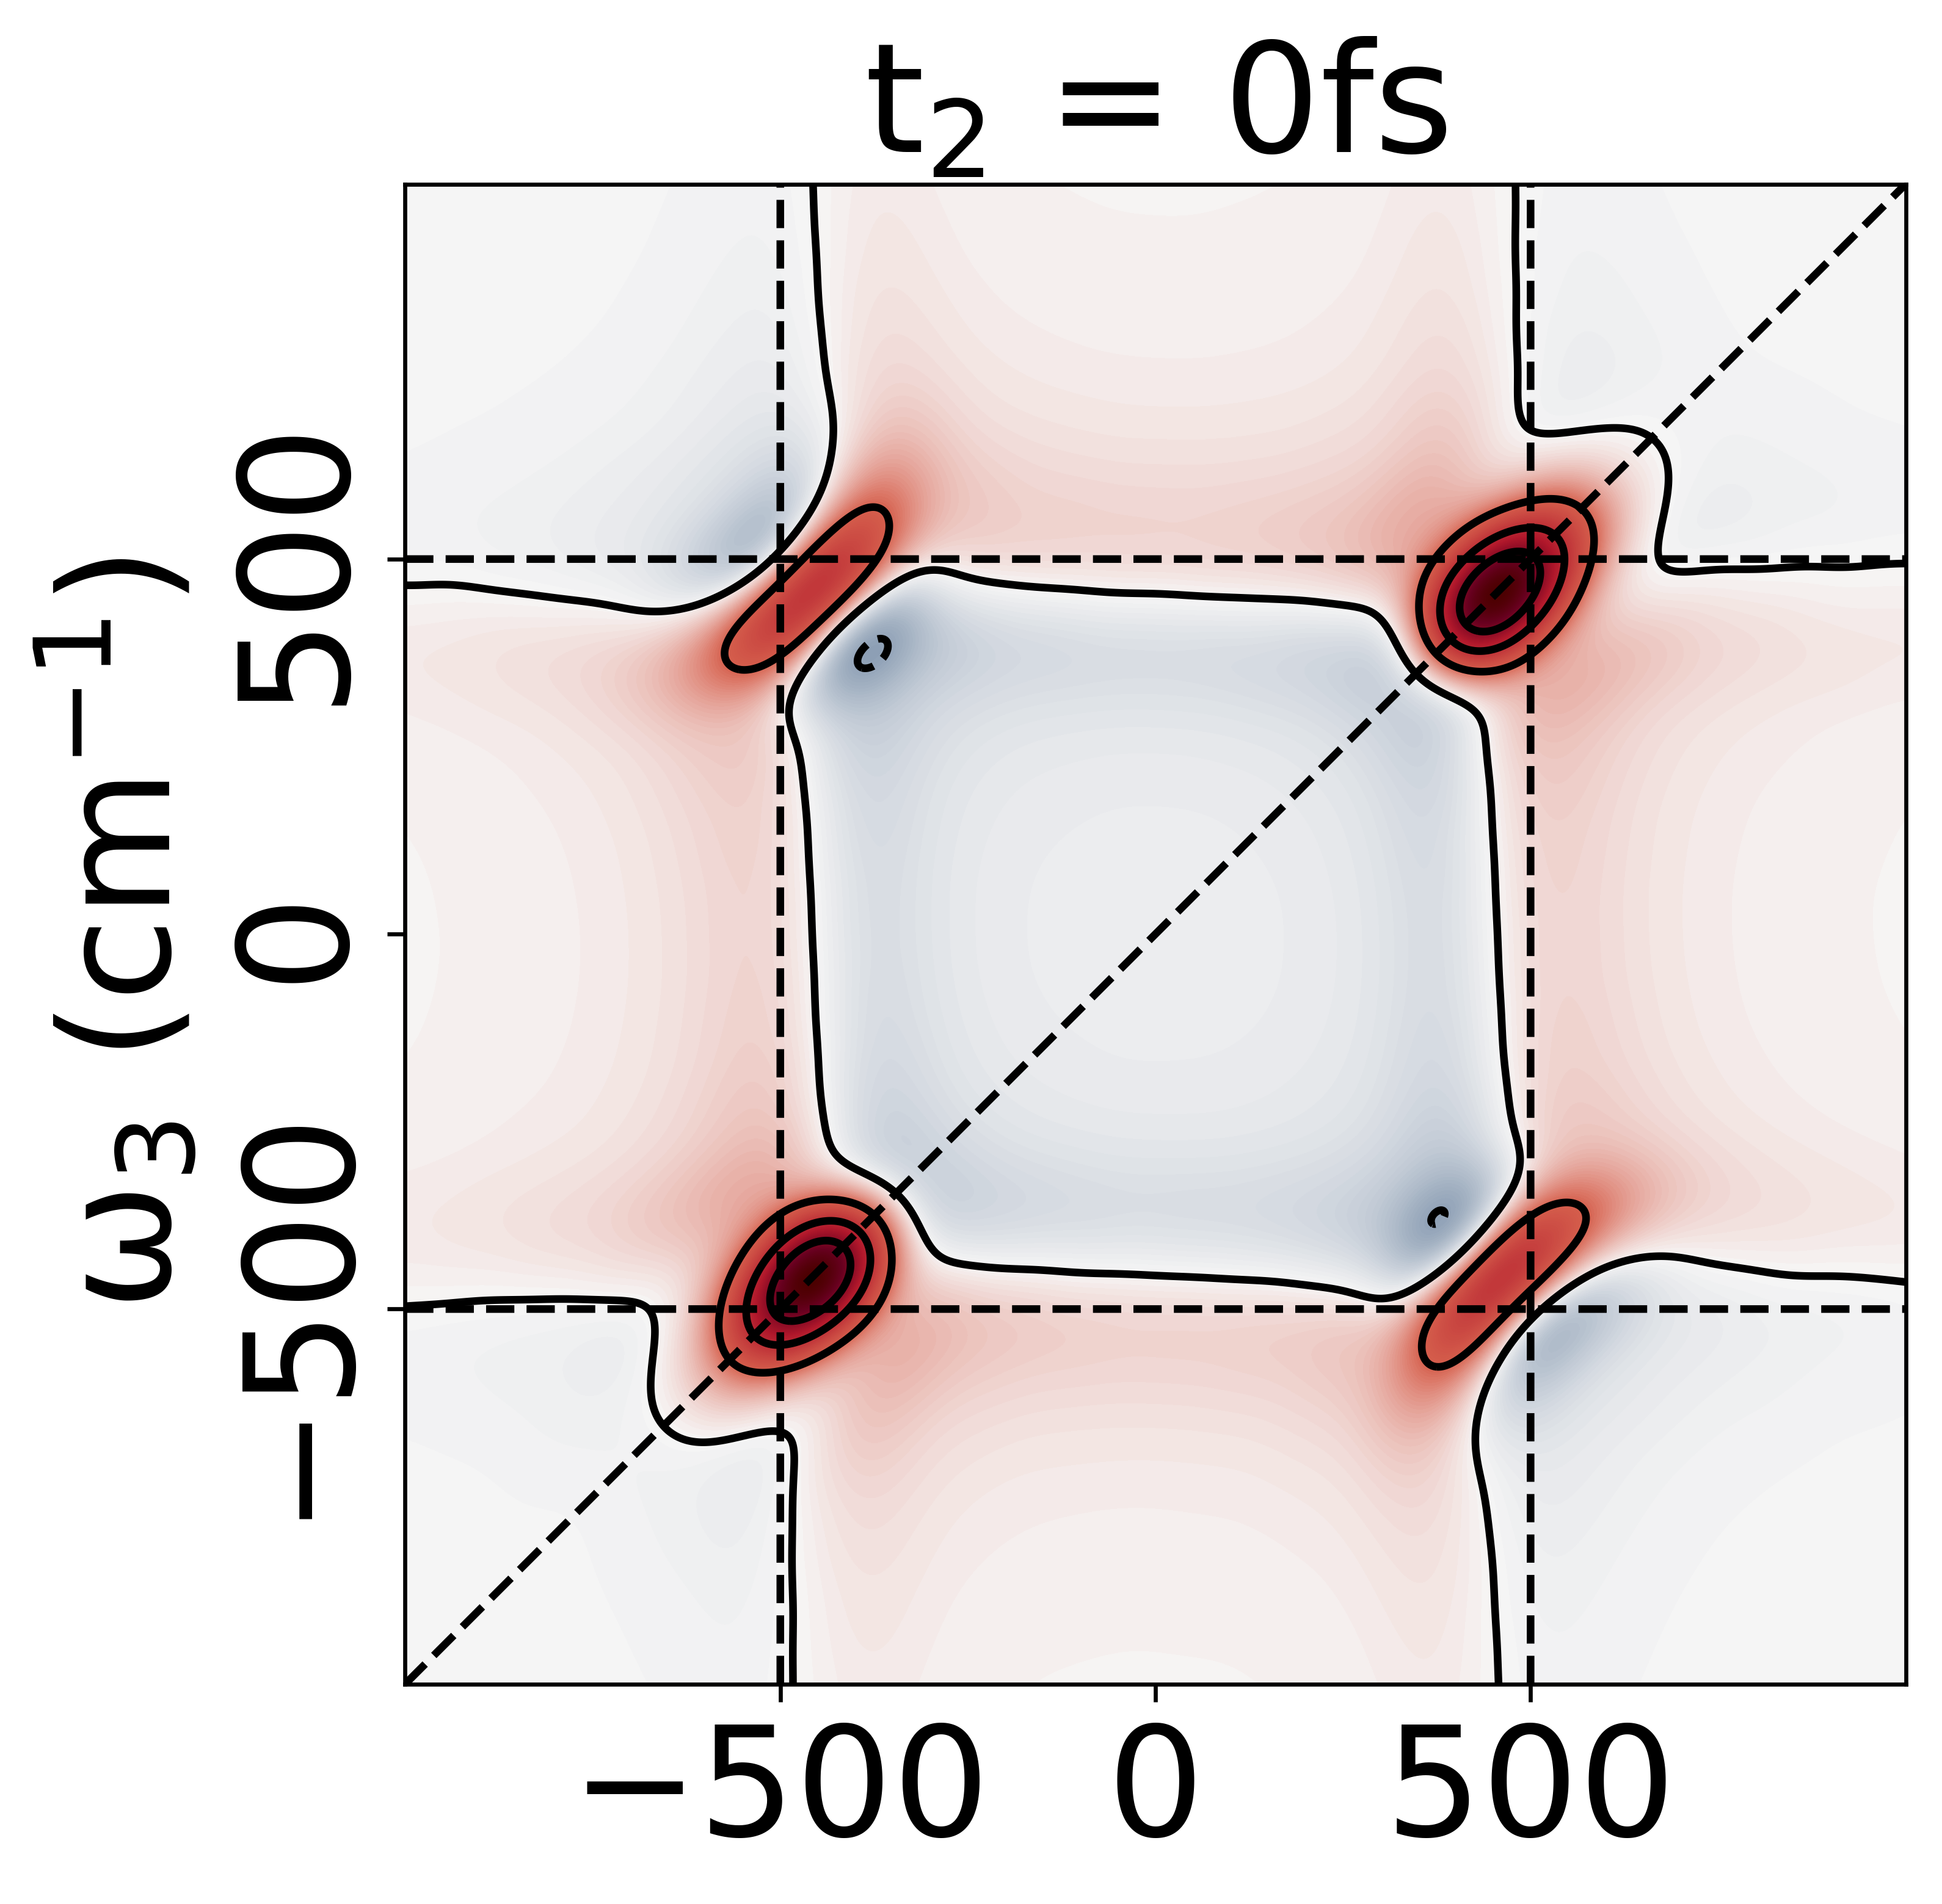
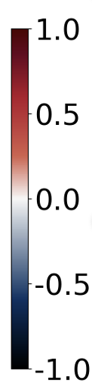
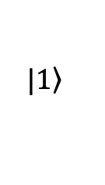
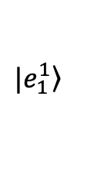
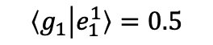
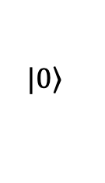
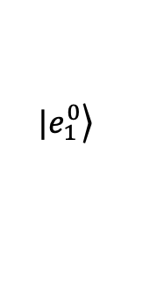
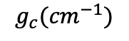
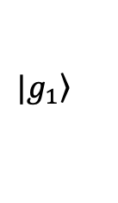
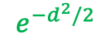
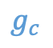

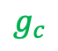
Overview
Spectroscopy
Results
Future works
$$g_{c}$$
$$e^{−d^{2}/2}$$
$$|\left.e_{1}^{1}\right\rangle$$
$$|\left.e_{1}^{0}\right\rangle$$
$$g_{c}$$
$$|\left.1\right\rangle$$
$$Γ$$
$$|\left.0\right\rangle$$
$$|\left.g_{1}\right\rangle$$
$$\left\langle g_{1} | e_{1}^{1}\right\rangle =0.5$$
$$g_{c}{(cm}^{−1})$$

Slide 3
Principles of Spectroscopy
See Molecular Excitation Dynamics and Relaxation, L. Valkunas, D. Abramavicius, T. Mancal

Slide 4
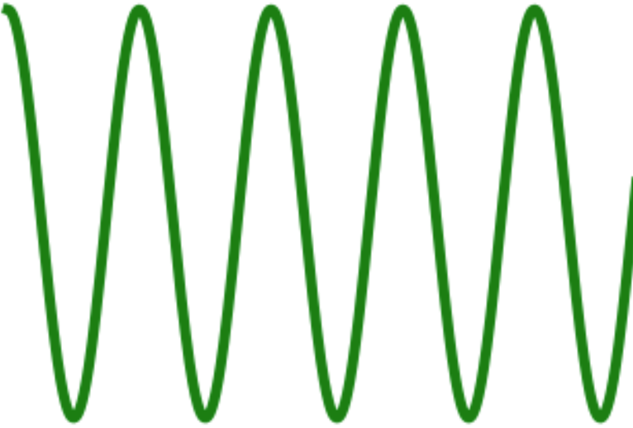
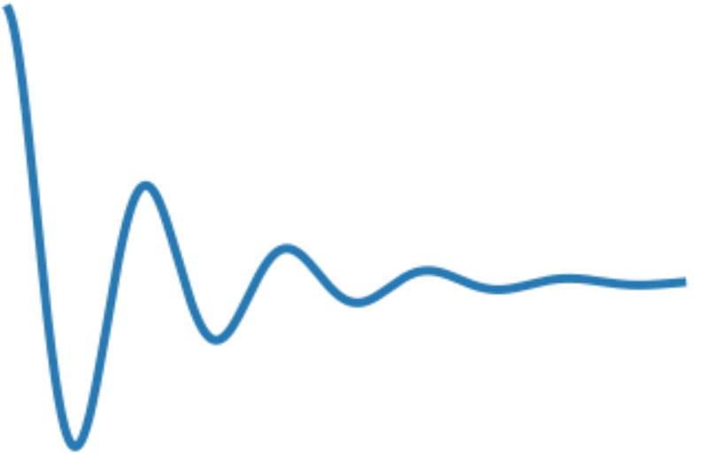
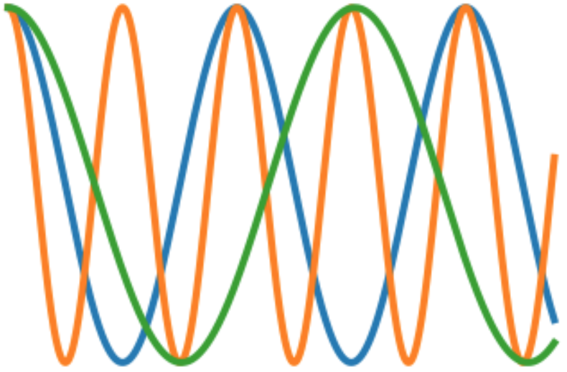
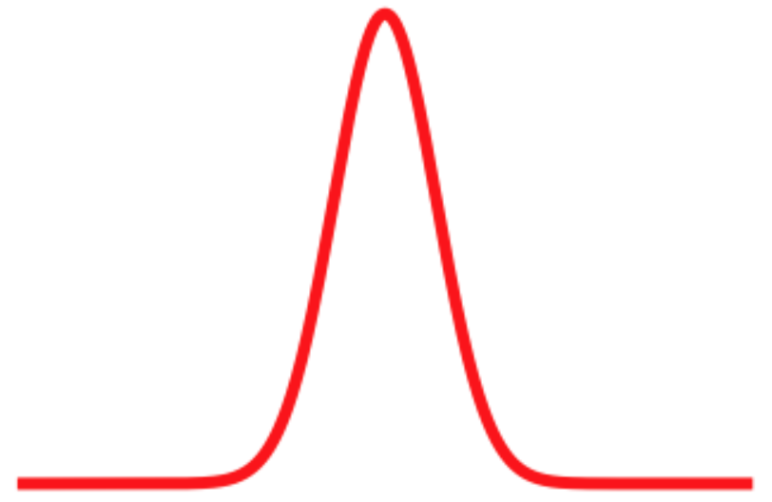
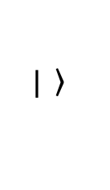
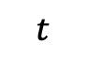
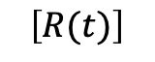
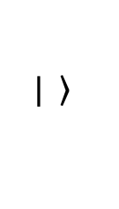

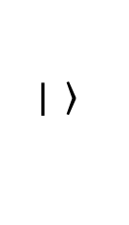

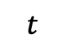
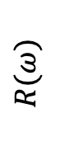
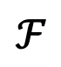
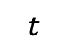
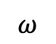
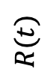
Linear Spectroscopy
$$P$$
$$\left.| \right\rangle$$
$$\left.| \right\rangle$$
+
$$\left.| \right\rangle$$
$$t$$
$$P$$
$$R(t)$$
$$t$$
$$t$$
$$ℱ$$
$$\left[R(t)\right]$$
$$R(ω)$$
$$ω$$

Slide 5
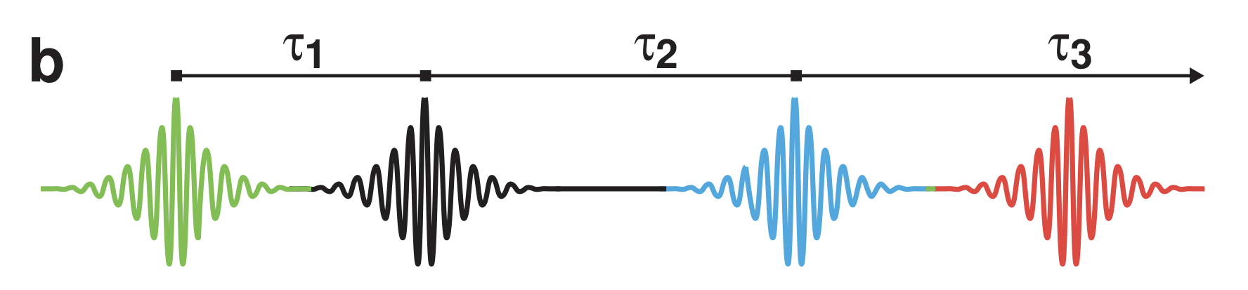
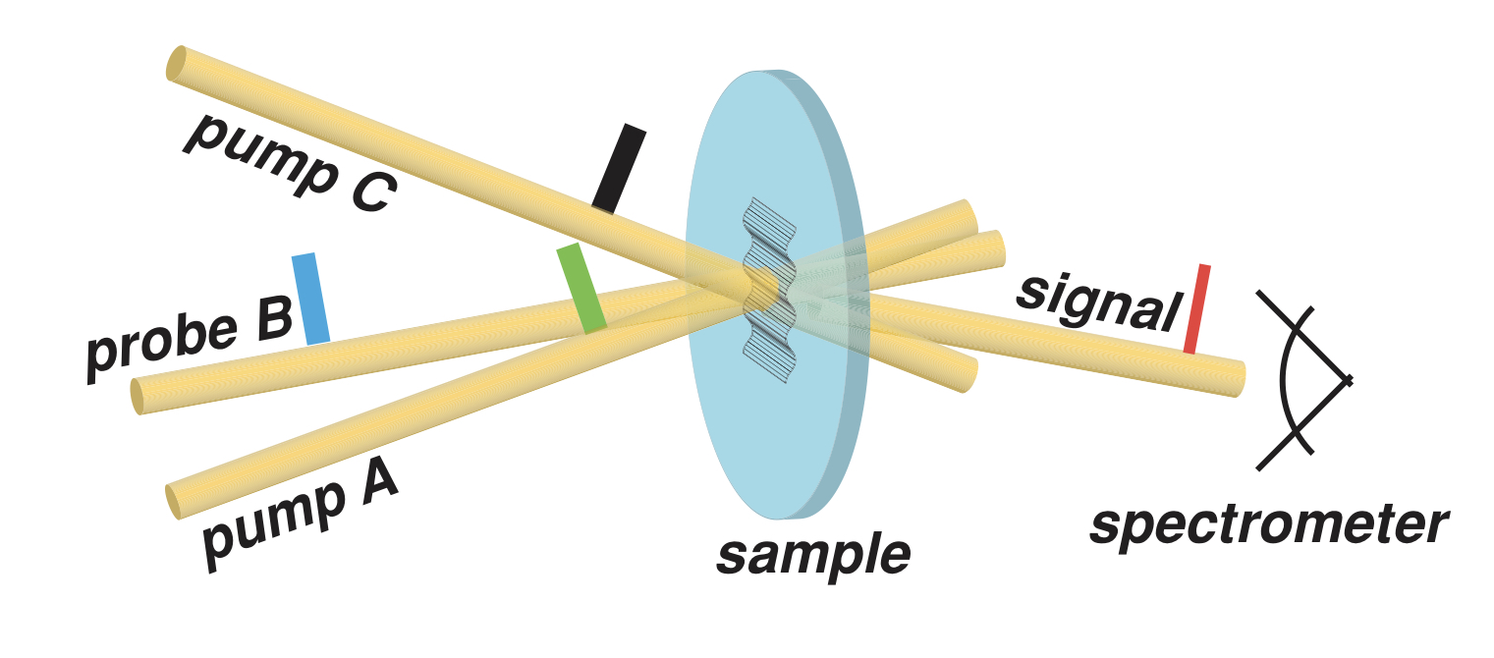
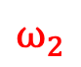
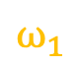
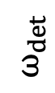
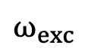
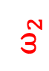
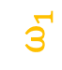
2D ES setup
Pulse Sequence
$$ω_{2}$$
$$ω_{det}$$
$$ω_{1}$$
$$ω_{1}$$
$$ω_{exc}$$
$$ω_{2}$$
Setup
Ann. Phys. (Berlin)526, No. 1–2, 31–49 (2014) / DOI 10.1002/andp.201300153

Slide 6
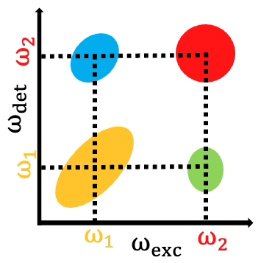
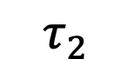
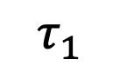
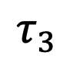
2D ES setup
$$τ_{1}$$
$$τ_{2}$$
$$τ_{3}$$

Slide 7
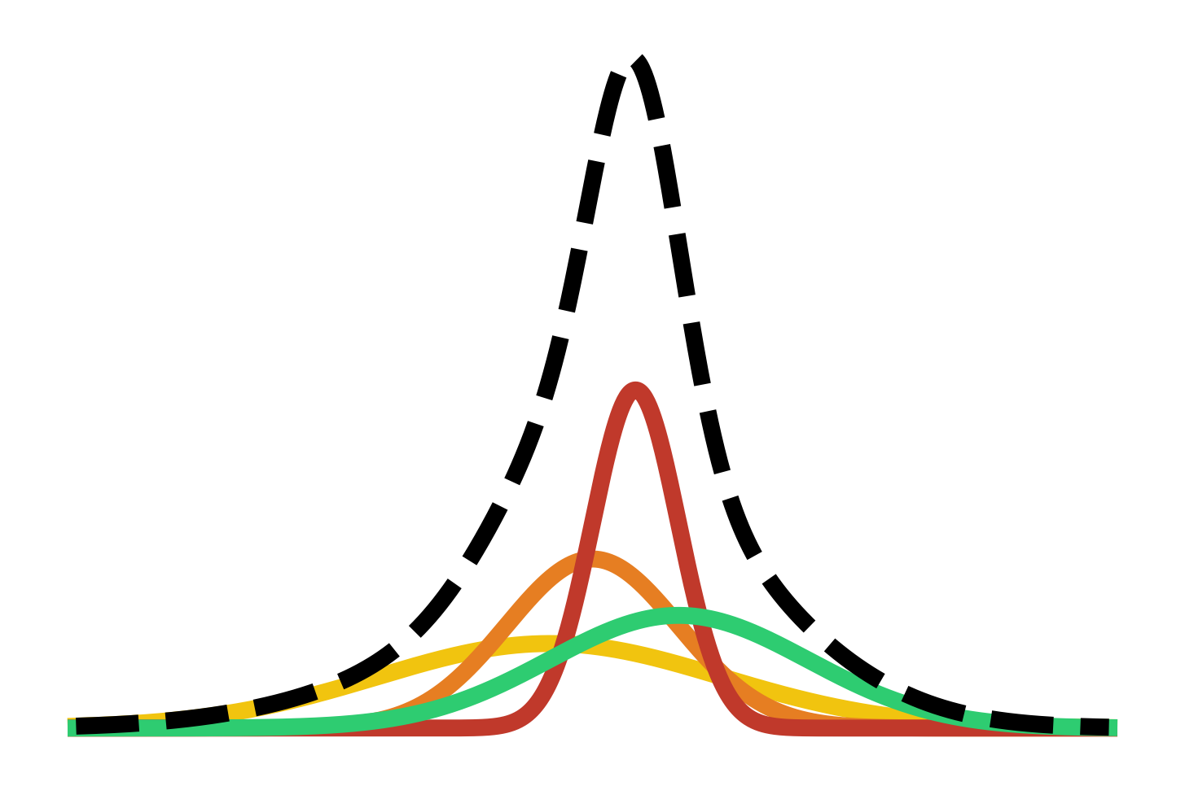
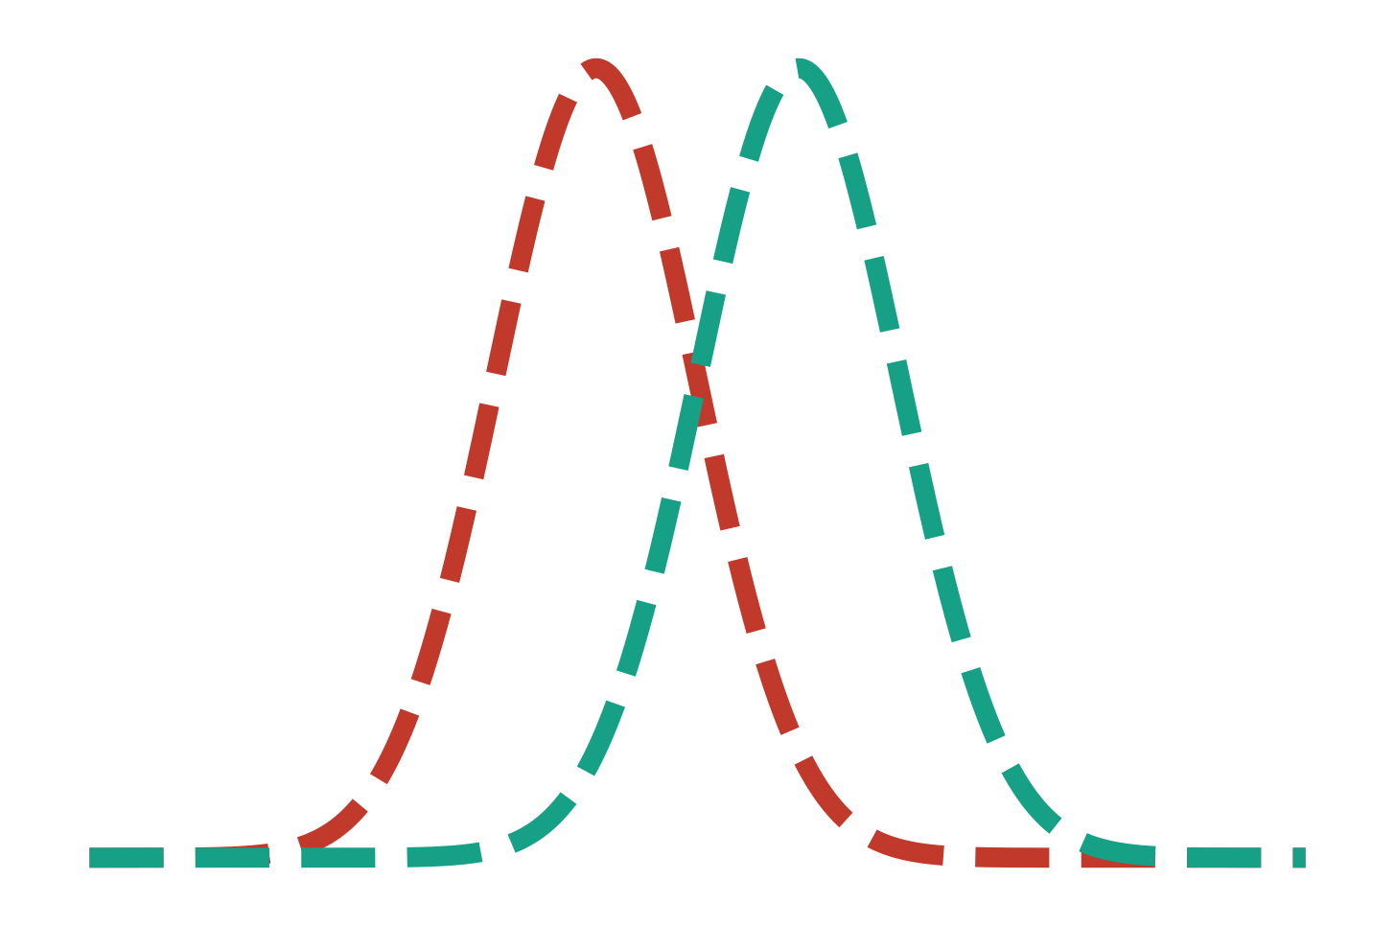
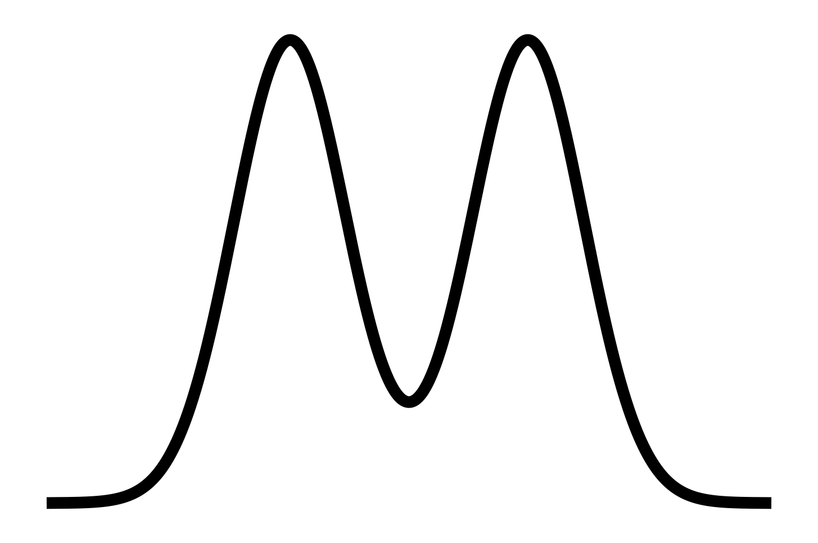
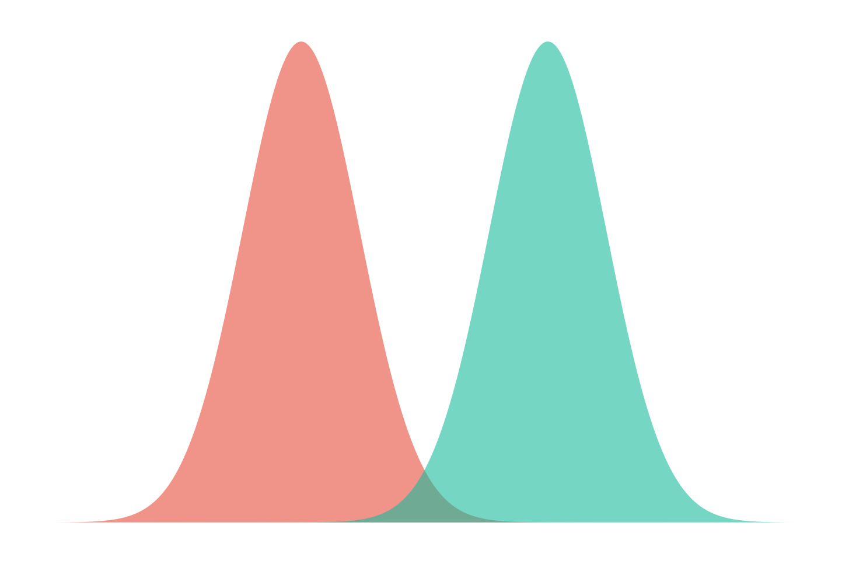




Limitations of linear spectroscopy
Inhomogeneous
Homogeneous
$$R(ω)$$
$$ω$$
Uncoupled
$$R(ω)$$
Coupled
$$ω$$

Slide 8




Inhomogeneous broadening in 2DES
$$ω_{3}$$
$$ω_{1}$$
Number of particles
$$ω$$

Slide 9



























Peak locations in 2DES
$$J_{12}$$
$$|\left.e_{2}\right\rangle$$
$$|\left.e_{1}\right\rangle$$
$$Δ=\frac{ω_{1}−ω_{2}}{2}$$
$$μ_{1}$$
$$μ_{2}$$
$$θ=\frac{1}{2}\tan^{−1}\left(\frac{J_{12}}{ℏΔ}\right)$$
$$|\left.g_{1}\right\rangle$$
$$ω_{2}$$
$$|\left.g_{2}\right\rangle$$
$$ω_{det}$$
$$\left.|f\right\rangle$$
$$ω_{1}$$
$\left({μ_{f−} \atop μ_{f+}}\right)$=$\left(\begin{matrix}\sin{θ} & \cos{θ} \\ \cos{θ} & −sin{θ}\end{matrix}\right)$ $\left({μ_{1} \atop μ_{2}}\right)$
$$μ_{f−}$$
$$μ_{f+}$$
$$\left.|−\right\rangle$$
$$ω_{1}$$
$$ω_{2}$$
$$\left.|+\right\rangle$$
$$ω_{exc}$$
$\left({μ_{−g} \atop μ_{+g}}\right)$=$\left(\begin{matrix}\sin{θ} & \cos{θ} \\ \cos{θ} & −sin{θ}\end{matrix}\right)$ $\left({μ_{1} \atop μ_{2}}\right)$
$$μ_{−g}$$
$$μ_{+g}$$
$$\left.|g\right\rangle$$

Slide 10

















































Liouville Pathways a.k.a Feynman Diagrams
$$S^{\left(3\right)}\left(t_{3},t_{2},t_{1}\right)∝i^{3}\left\langle µ[µ(t_{3}),[µ\left(t_{2}\right),\left[µ\left(t_{1}\right),ρ\right]]]\right\rangle$$
SE
GSB
ESA
$$\left.|g\right\rangle \left\langle g|\right.$$
$$\left.|g\right\rangle \left\langle g|\right.$$
$$\left.|e3\right\rangle \left\langle e2|\right.$$
$$\left.|e_{1}\right\rangle \left\langle g|\right.$$
$$\left.|e_{2}\right\rangle \left\langle g|\right.$$
$$\left.|f\right\rangle \left\langle e2|\right.$$
Non-Rephasing
$$t_{3}$$
$$t_{3}$$
$$t_{3}$$
$$e^{−iωt}$$
$$\left.|e_{1}\right\rangle \left\langle e_{2}|\right.$$
$$\left.|g\right\rangle \left\langle g|\right.$$
$$\left.|e1\right\rangle \left\langle e2|\right.$$
$$t_{2}$$
$$t_{2}$$
$$t_{2}$$
$$\left.|e_{1}\right\rangle \left\langle g|\right.$$
$$\left.|e_{1}\right\rangle \left\langle g|\right.$$
$$\left.|e1\right\rangle \left\langle g|\right.$$
$$t_{1}$$
$$t_{1}$$
$$t_{1}$$
$$e^{−iω_{eg}t}$$
$$\left.|g\right\rangle \left\langle g|\right.$$
$$\left.|g\right\rangle \left\langle g|\right.$$
$$\left.|g\right\rangle \left\langle g|\right.$$
$$t$$
$$\left.|g\right\rangle \left\langle g|\right.$$
$$\left.|g\right\rangle \left\langle g|\right.$$
$$\left.|e3\right\rangle \left\langle e1|\right.$$
$$e^{iωt}$$
$$\left.|e_{2}\right\rangle \left\langle g|\right.$$
$$\left.|e_{2}\right\rangle \left\langle g|\right.$$
$$\left.|f\right\rangle \left\langle e1|\right.$$
$$t_{3}$$
$$t_{3}$$
$$t_{3}$$
Rephasing
$$\left.|e_{2}\right\rangle \left\langle e_{1}|\right.$$
$$\left.|g\right\rangle \left\langle g|\right.$$
$$\left.|e2\right\rangle \left\langle e1|\right.$$
$$t_{2}$$
$$t_{2}$$
$$t_{2}$$
$$\left.|g\right\rangle \left\langle e_{1}|\right.$$
$$\left.|g\right\rangle \left\langle e_{1}|\right.$$
$$\left.|g\right\rangle \left\langle e1|\right.$$
$$t_{1}$$
$$t_{1}$$
$$t_{1}$$
$$\left.|g\right\rangle \left\langle g|\right.$$
$$\left.|g\right\rangle \left\langle g|\right.$$
$$\left.|g\right\rangle \left\langle g|\right.$$

Slide 11


















Polaritons
$$\left.|+\right\rangle$$
$$g_{c}$$
$$\left.|E_{i}\right\rangle$$
$$|\left.1\right\rangle$$
$$\left.|D\right\rangle$$
$$μ_{GE_{i}}$$
$$Γ$$
$$μ_{G+}$$
$$\left.|−\right\rangle$$
$$\left.|G\right\rangle$$
$$|\left.0\right\rangle$$
$$μ_{G−}$$
$$\left.|G\right\rangle$$

Slide 12





Simulating spectroscopy
Lindblad
PLDM
Lindblad

Slide 13
Results

Slide 14










Linear absorption of Polariton (Monomer in cavity)
$$|\left.e\right\rangle$$
$$g_{c}$$
$$|\left.1\right\rangle$$
$$μ$$
$$Γ$$
$$|\left.g\right\rangle$$
$$|\left.0\right\rangle$$
$$g_{c}=456{cm}^{−1}$$
$$Γ=10meV$$

Slide 15




















2DES of Polariton (Monomer in cavity)
$$\left.|+\right\rangle \left\langle −|\right.$$
$$\left.|+\right\rangle \left\langle +|\right.$$
$$g_{c}$$
$$|\left.1\right\rangle$$
$$|\left.e\right\rangle$$
$$μ$$
$$Γ$$
$$|\left.g\right\rangle$$
$$|\left.0\right\rangle$$
Inhomogeneous broadening
$$Ω_{c}$$
$$\left.|e,1\right\rangle$$
$$\frac{μ}{\sqrt{2}}$$
$$\frac{μ}{\sqrt{2}}$$
$$\left.|−\right\rangle$$
$$\left.|+\right\rangle$$
$$−\frac{μ}{\sqrt{2}}$$
$$\frac{μ}{\sqrt{2}}$$
$$\left.|−\right\rangle \left\langle −|\right.$$
$$\left.|−\right\rangle \left\langle +|\right.$$
$$\left.|g,0\right\rangle$$

Slide 16










Monomer in Cavity (varying loss rate)
$$\left.|e,1\right\rangle$$
$$\frac{μ}{\sqrt{2}}$$
$$\frac{μ}{\sqrt{2}}$$
$$\left.|−\right\rangle$$
$$\left.|+\right\rangle$$
$$−\frac{μ}{\sqrt{2}}$$
$$\frac{μ}{\sqrt{2}}$$
$$\left.|g,0\right\rangle$$

Slide 17










Monomer in Cavity (varying cavity couping)
$$\left.|e,1\right\rangle$$
$$\frac{μ}{\sqrt{2}}$$
$$\frac{μ}{\sqrt{2}}$$
$$\left.|−\right\rangle$$
$$\left.|+\right\rangle$$
$$−\frac{μ}{\sqrt{2}}$$
$$\frac{μ}{\sqrt{2}}$$
$$\left.|g,0\right\rangle$$

Slide 18











































2DES of Dimer in Cavity (Signal breakdown)
Rephasing
Non-Rephasing
Total
GSB
$$+$$
$$=$$
$$\left.{|e}_{1}e_{2}\right\rangle$$
$$\sqrt{2}g_{c}$$
$$+$$
$$+$$
$$+$$
$$|\left.2\right\rangle$$
$$μ_{2}$$
$$J_{12}$$
$$μ_{1}$$
$$2Γ$$
SE
$$+$$
$$=$$
$$\left.{|e}_{1}g_{2}\right\rangle$$
$$|\left.1\right\rangle$$
$$\left.{|g}_{1}e_{2}\right\rangle$$
$$+$$
$$+$$
$$+$$
$$μ_{1}$$
$$μ_{2}$$
$$g_{c}$$
$$Γ$$
ESA
$$+$$
$$=$$
$$\left.{|g}_{1}g_{2}\right\rangle$$
$$|\left.0\right\rangle$$
$$=$$
$$=$$
$$=$$
Total
$$+$$
$$=$$

Slide 19






























2DES of Dimer in Cavity (Coherence Enhancement)
(a)
$$g_{c}=100{cm}^{−1}$$
(b)
(c)
(a)
$$\left.{|e}_{1}e_{2}\right\rangle$$
$$\sqrt{2}g_{c}$$
$$|\left.2\right\rangle$$
(b)
$$μ_{2}$$
$$J_{12}$$
$$μ_{1}$$
$$2Γ$$
(d)
$$g_{c}=200{cm}^{−1}$$
(e)
(f)
$$\left.{|e}_{1}g_{2}\right\rangle$$
$$|\left.1\right\rangle$$
$$\left.{|g}_{1}e_{2}\right\rangle$$
$$μ_{1}$$
$$μ_{2}$$
$$g_{c}$$
$$Γ$$
(c)
$$\left.{|g}_{1}g_{2}\right\rangle$$
$$|\left.0\right\rangle$$
(g)
$$g_{c}=500{cm}^{−1}$$
(h)
(i)
(d)

Slide 20
Questions!!!

Slide 21
































Polaron decoupling
$$g_{c}$$
$$e^{−d^{2}/2}$$
$$|\left.e_{3}^{1}\right\rangle$$
$$|\left.e_{1}^{1}\right\rangle$$
$$g_{c}$$
$$|\left.1\right\rangle$$
$$|\left.e_{2}^{1}\right\rangle$$
$\left\langle g_{1} | e_{1}^{0}\right\rangle$=1
$$|\left.e_{1}^{0}\right\rangle$$
$$|\left.e_{3}^{0}\right\rangle$$
$$|\left.e_{1}^{1}\right\rangle$$
$$\left\langle g_{1} | e_{1}^{1}\right\rangle \sim e^{−d^{2}/2}$$
$$Γ$$
$$|\left.e_{2}^{0}\right\rangle$$
$$λ$$
$$|\left.g_{1}\right\rangle$$
$$|\left.e_{1}^{0}\right\rangle$$
$$|\left.0\right\rangle$$
Energy
$$μ\left\langle g_{1} | e_{1}^{1}\right\rangle$$
$$\left\langle g_{1} | e_{1}^{1}\right\rangle =0.5$$
$$\left\langle g_{1} | e_{1}^{1}\right\rangle =0.05$$
$$μ\left\langle g_{1} | e_{1}^{0}\right\rangle$$
$$|\left.g_{3}\right\rangle$$
$$|\left.g_{2}\right\rangle$$
$$|\left.g_{1}\right\rangle$$
$$d$$
$$g_{c}{(cm}^{−1})$$
$$g_{c}{(cm}^{−1})$$
Bath coordinate

Slide 22


Watanabe-Takahashi Experiment
J. Phys. Chem. Lett. 2020, 11, 4, 1349–1356 ACS Nano 2022 16 (3), 4693-4704

Slide 23








Polaron decoupling : Preliminary results
$$3 level system$$
$$g_{c}=0.1eV$$
$$g_{c}=0.2eV$$
$$g_{c}=0.4eV$$

Slide 24

















Probing dark states
2nd excitation manifold
$$\left.|+_{2}\right\rangle$$
$$\left.|+_{2}/−_{2}\right\rangle = \sqrt{\frac{N}{2(2N−1)}}\left.|G,2\right\rangle ±\frac{1}{\sqrt{2N}}\sum_{i=1}^{N}{\left.|e_{i},1\right\rangle }+\frac{1}{\sqrt{N(2N−1)}}\sum_{i=1,j>1}^{N}{|e_{i},e_{j},\left.0\right\rangle }$$
$$μ_{{D+}_{2}}$$
$$\left.|2ω\right\rangle$$
$$\left.|−_{2}\right\rangle$$
$$\left.|2ω\right\rangle = \sqrt{\frac{N−1}{2N−1}}\left.|G,2\right\rangle −\sqrt{\frac{2}{(N−1)(2N−1)}}\sum_{i=1}^{N}{\left.|e_{i},e_{j},0\right\rangle }$$
$$μ_{{D−}_{2}}$$
$$μ_{D2ω}$$
$$\left.|+\right\rangle$$
Dark to 2nd excitation manifold transition (ESA peaks)
$$μ_{{D+}_{2}}= \left\langle +_{2} | µ | D\right\rangle =\frac{1}{N\sqrt{(2N−1)}}\sum_{i=1,j>1}^{N}{\sum_{k=1}^{N}{c_{k}\left\langle e_{i},e_{j},0 | µ | e_{k},0\right\rangle }}$$
$$\left.|D\right\rangle$$
$$μ_{G+}$$
$$\left.|−\right\rangle$$
$$μ_{{D−}_{2}}=\left\langle −_{2} | µ | D\right\rangle =\frac{1}{N\sqrt{(2N−1)}}\sum_{i=1,j>1}^{N}{\sum_{k=1}^{N}{c_{k}\left\langle e_{i},e_{j},0 | µ | e_{k},0\right\rangle }}$$
$$μ_{G−}$$
$$μ_{D2ω}= \left\langle 2ω | µ | D\right\rangle =−\sqrt{\frac{2}{N(N−1)(2N−1)}}\sum_{i=1,j>1}^{N}{\sum_{k=1}^{N}{c_{k}\left\langle e_{i},e_{j},0 | µ | e_{k},0\right\rangle }}$$
$$\left.|G\right\rangle$$

Slide 25






Probing dark states (peak locations)
$$\left.|+_{2}\right\rangle$$
$$μ_{{D+}_{2}}$$
$$\left.|2ω\right\rangle$$
$$\left.|−_{2}\right\rangle$$
$$ω_{+}$$
$$μ_{{D−}_{2}}$$
$$μ_{D2ω}$$
$$\left.|+\right\rangle$$
$$ω_{det}$$
$$\left.|D\right\rangle$$
$$ω_{−}$$
$$μ_{G+}$$
$$\left.|−\right\rangle$$
$$ω_{−}$$
$$ω_{+}$$
$$μ_{G−}$$
$$ω_{exc}$$
$$\left.|G\right\rangle$$

Slide 26


Proposal-3: Transient absorption of Polaritons
J. Phys. Chem. Lett. 2020, 11, 7, 2667–2674

Slide 27


Proposal-4: 2DIR simulations of VSC
J. Phys. Chem. A 2019, 123, 28, 5918–5927

Slide 28
Backup

Slide 29







Breakdown of monomer 2DES signals
Rephasing
Non-Rephasing
Total
$$Γ=0meV$$
$$Γ=20meV$$

Slide 30












Detuning
$$δ=−100{cm}^{−1}$$
$$δ=−200{cm}^{−1}$$
$$δ=−500{cm}^{−1}$$
$$δ=100{cm}^{−1}$$
$$δ=200{cm}^{−1}$$
$$δ=500{cm}^{−1}$$

Slide 31



$$τ_{1}$$
$$τ_{2}$$
$$τ_{3}$$

Slide 32


$$Γ$$
𝛌
$$λ$$
$$Γ$$

Slide 33


𝓛-PLDM Spectroscopy
$$Γ$$
𝛌
$$λ$$
$$Γ$$
Non-Markovian
Markovian
Lindblad
PLDM
Lindblad
J. Chem. Phys. 159, 094102 (2023)

Slide 34












Spectra of molecules in Cavity
(a)
$$g_{c}=100{cm}^{−1}$$
(b)
(c)
(a)
Absorption
(b)
$$g_{c}=200{cm}^{−1}$$
(d)
(e)
(f)
(c)
Absorption
(g)
$$g_{c}=500{cm}^{−1}$$
(h)
(i)
(d)
J. Chem. Phys. 159, 094102 (2023)

